Slide 1
Murach’s C# (8th Edition)
Chapter 22
How to use the DataGridView control

Slide 2
Objectives
Applied
Use a DataGridView control to display data from a data source.
Customize the appearance and operation of a DataGridView control.
Use paging with a DataGridView control.
Use a DataGridView control as part of a Master/Detail form.
Knowledge
Describe the use of a data transfer object (DTO) and when you should use one.

Slide 3
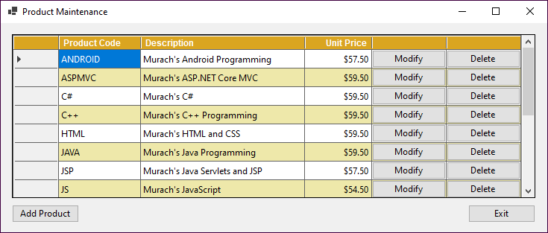
A DataGridView control that displays a list of products

Slide 4
Common properties of the DataGridView class
Rows
Columns
DataSource

Slide 5
Common method of the DataGridView class
AutoResizeColumns()

Slide 6
DataGridView control concepts
You can use a DataGridView control to display data in a row and column format.
The intersection of a row and column is called a cell.
You can also use a DataGridView control to add, update, and delete data.

Slide 7
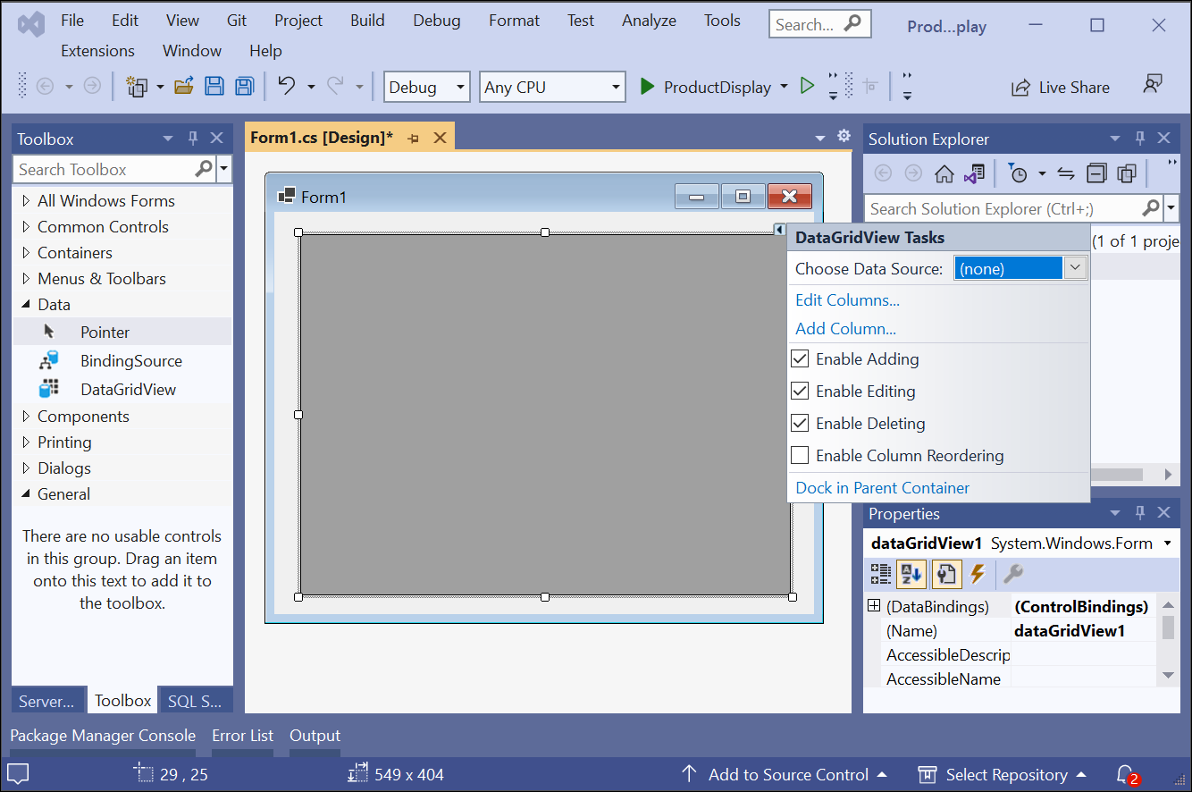
A DataGridView control after it’s added to a form

Slide 8
Properties that you can set from the smart tag menu
AllowUserToAddRows
AllowUserToDeleteRows
AllowUsersToOrderColumns
ReadOnly

Slide 9
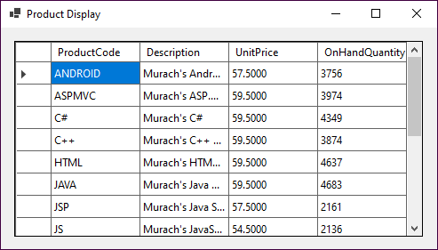
A DataGridView control that’s bound to a data source

Slide 10
How to bind a DataGridView control to an entity collection
MMABooksContext context = new();
dgvProducts.DataSource =
context.Products.ToList();

Slide 11
How to bind a DataGridView control to the results of a query
MMABooksContext context = new();
var products = context.Products.OrderBy(
p => p.Description).Select(
p => new { p.ProductCode, p.Description, p.UnitPrice,
p.OnHandQuantity }).ToList();
dgvProducts.DataSource = products;

Slide 12
How to bind a DataGridView control to a list of objects created in code
List<Product> products = GetAllProducts();
dgvProducts.DataSource = products;

Slide 13
A data transfer object that includes properties for the selected columns
public record ProductDTO(string ProductCode,
string Description, decimal UnitPrice);

Slide 14
A data access class that uses EF Core to return a list of DTO objects
public class MMABooksDataAccess
{
private MMABooksContext context = new();
public List<ProductDTO> GetAllProducts() =>
context.Products
.OrderBy(p => p.Description)
.Select(p => new ProductDTO(
p.ProductCode, p.Description,
p.UnitPrice))
.ToList();
}

Slide 15
A data access class that uses ADO.NET to return a list of DTO objects
public class MMABooksDataAccess
{
// get connection string
public List<ProductDTO> GetAllProducts()
{
List<ProductDTO> products = new();
string selectStatement =
"SELECT ProductCode, Description, UnitPrice "
+ "FROM Products ORDER BY Description";
// create connection and command
// and open connection
// create and open data reader

Slide 16
A data access class that uses ADO.NET to return a list of DTO objects (continued)
while (reader.Read())
{
products.add(new ProductDTO(
reader["ProductCode"].ToString()!,
reader["Description"].ToString()!,
(decimal)reader["UnitPrice"]));
}
return products;
}
}

Slide 17
Code that calls the method to get the data for DataGridView controls
dgvProducts.DataSource = data.GetAllProducts();

Slide 18
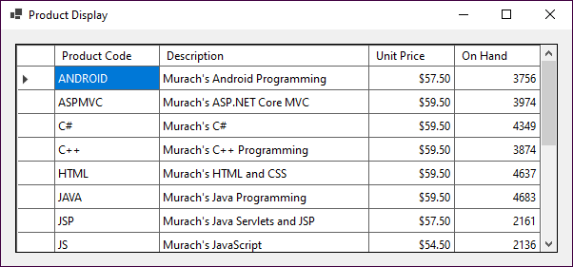
A DataGridView control after its columns are formatted

Slide 19
Common properties of the DataGridViewColumn class for formatting
HeaderText
Width
DefaultCellStyle

Slide 20
Common properties used for cell styles
Format
BackColor
ForeColor
Alignment
Font

Slide 21
Code that changes some of the formatting for the columns in a grid
dgvProducts.Columns[0].HeaderText = "Product Code";
dgvProducts.Columns[1].Width = 300;
dgvProducts.Columns[2].DefaultCellStyle.Format = "c";
dgvProducts.Columns[2].DefaultCellStyle.Alignment =
DataGridViewContentAlignment.MiddleRight;

Slide 22
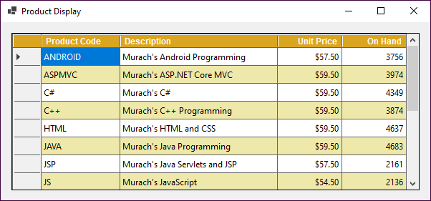
A DataGridView control after its headers and rows are formatted

Slide 23
Common properties of the DataGridView class for formatting
EnableHeadersVisualStyles
ColumnHeadersDefaultCellStyle
AlternatingRowsDefaultCellStyle

Slide 24
Common properties of the DataGridViewColumn class for formatting headers
SortMode
HeaderCell

Slide 25
Common property of the DataGridViewCell class for formatting
Style

Slide 26
Code that changes some of the formatting for a grid
dgvProducts.EnableHeadersVisualStyles = false;
dgvProducts.ColumnHeadersDefaultCellStyle.Font =
new Font("Arial", 9, FontStyle.Bold);
dgvProducts.ColumnHeadersDefaultCellStyle.BackColor =
Color.Goldenrod;
dgvProducts.ColumnHeadersDefaultCellStyle.ForeColor =
Color.White;
dgvProducts.AlternatingRowsDefaultCellStyle.BackColor =
Color.PaleGoldenrod;
dgvProducts.Columns[2].HeaderCell.Style.Alignment =
DataGridViewContentAlignment.MiddleRight;

Slide 27
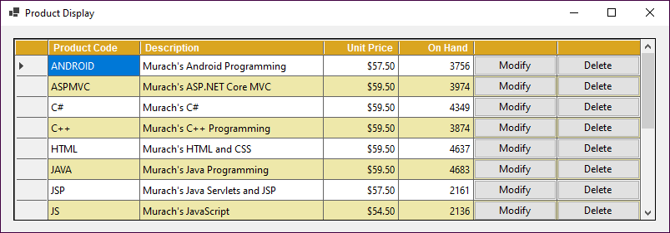
A DataGridView control with two button columns

Slide 28
Common properties of the DataGridViewButtonColumn class
HeaderText
Text
UseColumnTextForButtonValue

Slide 29
Common methods of the DataGridViewColumnCollection class
Add(column)
Insert(index, column)
Remove(column)
RemoveAt(index)

Slide 30
Code that adds a button column to a DataGridView control
DataGridViewButtonColumn deleteColumn = new() {
HeaderText = "";
UseColumnTextForButtonValue = true;
Text = "Delete";
}
dgvProducts.Columns.Add(deleteColumn);

Slide 31
A statement that deletes a column from a DataGridView control
dgvProducts.Columns.RemoveAt(4);

Slide 32
Properties of the DataGridViewCellEventArgs class
RowIndex
ColumnIndex

Slide 33
A property of the DataGridViewRow class
Cells

Slide 34
A property of the DataGridViewCell class
Value

Slide 35
Code that handles the CellClick event of a DataGridView control
private MMABooksDataAccess data = new();
private Product selectedProduct = null!;
private void dgvProducts_CellClick(object sender,
DataGridViewCellEventArgs e)
{
const int ModifyIndex = 4;
const int DeleteIndex = 5;
if (e.RowIndex > -1)
{
if (e.ColumnIndex == ModifyIndex ||
e.ColumnIndex == DeleteIndex)
{
DataGridViewCell cell =
dgvProducts.Rows[e.RowIndex].Cells[0];
string productCode =
cell.Value?.ToString()?.Trim() ?? "";
selectedProduct =
data.FindProduct(productCode)!;
}

Slide 36
Code that handles the CellClick event of a DataGridView control (continued)
if (e.ColumnIndex == ModifyIndex)
ModifyProduct();
else if (e.ColumnIndex == DeleteIndex)
DeleteProduct();
}
}

Slide 37

The Product Maintenance form

Slide 38
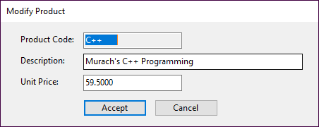
The Add/Modify Product form

Slide 39
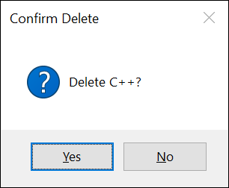
The dialog for confirming a delete operation

Slide 40
Code for the Product Maintenance form (part 1)
private MMABooksDataAccess data = new();
private Product selectedProduct = null!;
private void frmProductMaintenance_Load(object sender, EventArgs e)
{
DisplayProducts();
}

Slide 41
Code for the Product Maintenance form (part 2)
private void DisplayProducts()
{
dgvProducts.Columns.Clear();
dgvProducts.DataSource = data.GetAllProducts();
// add column for modify button
DataGridViewButtonColumn modifyColumn = new() {
UseColumnTextForButtonValue = true,
HeaderText = "",
Text = "Modify"
};
dgvProducts.Columns.Add(modifyColumn);
// add column for delete button
DataGridViewButtonColumn deleteColumn = new() {
UseColumnTextForButtonValue = true,
HeaderText = "",
Text = "Delete"
};

Slide 42
Code for the Product Maintenance form (part 3)
dgvProducts.Columns.Add(deleteColumn);
// format the column headers
dgvProducts.EnableHeadersVisualStyles = false;
dgvProducts.ColumnHeadersDefaultCellStyle.Font =
new Font("Arial", 9, FontStyle.Bold);
dgvProducts.ColumnHeadersDefaultCellStyle.BackColor =
Color.Goldenrod;
dgvProducts.ColumnHeadersDefaultCellStyle.ForeColor =
Color.White;
// format the odd numbered rows
dgvProducts.AlternatingRowsDefaultCellStyle.BackColor =
Color.PaleGoldenrod;
// format the first column
dgvProducts.Columns[0].HeaderText = "Product Code";
dgvProducts.Columns[0].Width = 200;

Slide 43
Code for the Product Maintenance form (part 4)
// format the second column
dgvProducts.Columns[1].Width = 350;
// format the third column
dgvProducts.Columns[2].HeaderText = "Unit Price";
dgvProducts.Columns[2].HeaderCell.Style.Alignment =
DataGridViewContentAlignment.MiddleRight;
dgvProducts.Columns[2].Width = 135;
dgvProducts.Columns[2].DefaultCellStyle.Format = "c";
dgvProducts.Columns[2].DefaultCellStyle.Alignment =
DataGridViewContentAlignment.MiddleRight;

Slide 44
Code for the Product Maintenance form (part 5)
private void dgvProducts_CellClick(object sender,
DataGridViewCellEventArgs e) {
// store index values for Modify and Delete button columns
const int ModifyIndex = 3;
const int DeleteIndex = 4;
if (e.RowIndex > -1) // make sure header row wasn't clicked
{
if (e.ColumnIndex == ModifyIndex ||
e.ColumnIndex == DeleteIndex)
{
string productCode = dgvProducts.Rows[e.RowIndex]
.Cells[0].Value?.ToString()?.Trim() ?? "";
selectedProduct = data.FindProduct(productCode)!;
}
if (selectedProduct != null)
{
if (e.ColumnIndex == ModifyIndex)
ModifyProduct();
else if (e.ColumnIndex == DeleteIndex)
DeleteProduct();
}
}
}

Slide 45
Code for the Product Maintenance form (part 6)
private void ModifyProduct()
{
frmAddModify addModifyForm = new() {
Product = selectedProduct
};
DialogResult result = addModifyProductForm.ShowDialog();
if (result == DialogResult.OK)
{
try {
selectedProduct = addModifyForm.Product;
data.UpdateProduct(selectedProduct);
DisplayProducts();
}
catch (DataAccessException ex)
{
HandleDataAccessError(ex);
}
}
}

Slide 46
Code for the Product Maintenance form (part 7)
private void DeleteProduct()
{
DialogResult result =
MessageBox.Show(
$"Delete {selectedProduct.ProductCode.Trim()}?",
"Confirm Delete", MessageBoxButtons.YesNo,
MessageBoxIcon.Question);
if (result == DialogResult.Yes)
{
try
{
data.RemoveProduct(selectedProduct);
DisplayProducts();
}
catch (DataAccessException ex)
{
HandleDataAccessError(ex);
}
}
}

Slide 47
Code for the Product Maintenance form (part 8)
private void btnAdd_Click(object sender, EventArgs e)
{
frmAddModify addModifyForm = new();
DialogResult result = addModifyProductForm.ShowDialog();
if (result == DialogResult.OK)
{
try
{
selectedProduct = addModifyForm.Product;
data.AddProduct(selectedProduct);
DisplayProducts();
}
catch (DataAccessException ex)
{
HandleDataAccessError(ex);
}
}
}

Slide 48
Code for the Product Maintenance form (part 9)
private void HandleDataAccessError(DataAccessException ex)
{
if (ex.IsConcurrencyError)
{
DisplayProducts();
}
MessageBox.Show(ex.Message, ex.ErrorType);
}
private void btnExit_Click(object sender, EventArgs e)
{
this.Close();
}

Slide 49
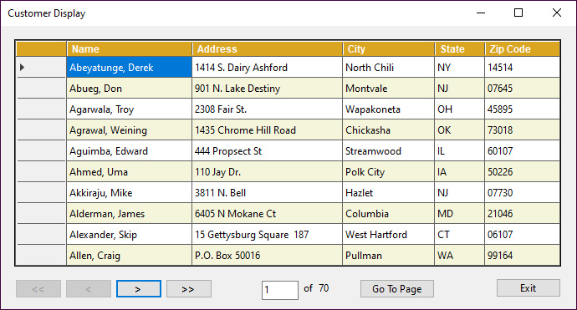
A Customer Display form that provides for paging

Slide 50
The DTO and data access class
public record CustomerDTO(string Name, string Address,
string City, string State, string ZipCode);
public class MMABooksDataAccess
{
private MMABooksContext context = new();
public int CustomerCount =>
context.Customers.Count();
public List<CustomerDTO> GetCustomers(int skip,
int take) =>
context.Customers
.OrderBy(c => c.Name)
.Select(c => new CustomerDTO(
c.Name, c.Address, c.City,
c.State, c.ZipCode))
.Skip(skip)
.Take(take)
.ToList();
}

Slide 51
The code that implements the paging (part 1)
private MMABooksDataAccess data = new();
private const int MaxRows = 10;
private int totalRows = 0;
private int pages = 0;
private void frmCustDisplay_Load(object sender, EventArgs e)
{
totalRows = data.CustomerCount;
pages = totalRows / MaxRows;
if (totalRows % MaxRows != 0) {
pages += 1;
}
lblPages.Text = pages.ToString();
DisplayCustomers(1);
}

Slide 52
The code that implements the paging (part 2)
private void DisplayCustomers(int pageNumber)
{
txtPage.Text = pageNumber.ToString();
int skip = MaxRows * (pageNumber - 1);
int take = MaxRows;
if (pageNumber == pages) {
take = totalRows - skip;
}
if (totalRows <= MaxRows) {
take = totalRows;
}
dgvCustomers.DataSource = data.GetCustomers(skip, take);
// Code that formats the DataGridView control goes here
EnableDisableButtons(pageNumber);
}

Slide 53
The code that implements the paging (part 3)
private void EnableDisableButtons(int pageNumber)
{
if (pageNumber == 1) {
btnFirst.Enabled = false;
btnPrev.Enabled = false;
} else {
btnFirst.Enabled = true;
btnPrev.Enabled = true;
}
if (pageNumber == pages) {
btnNext.Enabled = false;
btnLast.Enabled = false;
} else {
btnNext.Enabled = true;
btnLast.Enabled = true;
}
if (totalRows <= MaxRows) {
btnGoTo.Enabled = false;
}
}

Slide 54
The code that implements the paging (part 4)
private void btnFirst_Click(object sender, EventArgs e)
{
DisplayCustomers(1);
}
private void btnPrev_Click(object sender, EventArgs e)
{
int pageNumber = Convert.ToInt32(txtPage.Text);
pageNumber -= 1;
DisplayCustomers(pageNumber);
}
private void btnNext_Click(object sender, EventArgs e)
{
int pageNumber = Convert.ToInt32(txtPage.Text);
pageNumber += 1;
DisplayCustomers(pageNumber);
}
private void btnLast_Click(object sender, EventArgs e)
{
DisplayCustomers(pages);
}

Slide 55
The code that implements the paging (part 5)
private void btnGoTo_Click(object sender, EventArgs e)
{
if (IsValidData()) {
int pageNumber = Convert.ToInt32(txtPage.Text);
DisplayCustomers(pageNumber);
}
}

Slide 56
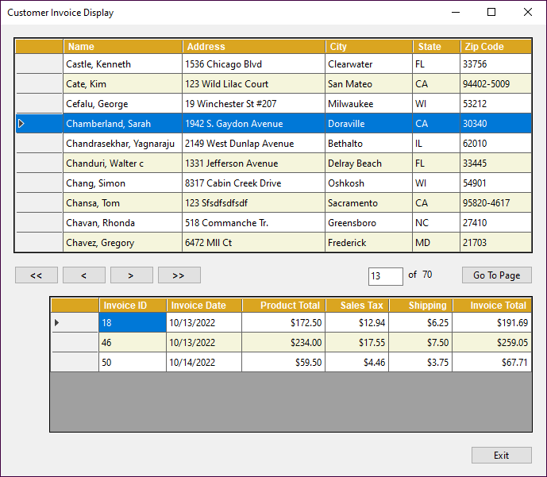
A Master/Detail form with customers and invoices

Slide 57
The DTOs and data access class
public record CustomerDTO(int CustomerId, string Name,
string Address, string City, string State, string ZipCode);
public record InvoiceDTO(int InvoiceId, DateTime InvoiceDate,
decimal ProductTotal, decimal SalesTax, decimal Shipping,
decimal InvoiceTotal);
public class MMABooksDataAccess
{
private MMABooksContext context = new();
public int CustomerCount => context.Customers.Count();
public List<CustomerDTO> GetCustomers(int skip, int take) =>
context.Customers.OrderBy(c => c.Name)
.Select(c => new CustomerDTO(
c.CustomerId, c.Name, c.Address,
c.City, c.State, c.ZipCode))
.Skip(skip).Take(take).ToList();

Slide 58
The DTOs and data access class (continued)
public List<InvoiceDTO> GetCustomerInvoices(int customerID) =>
context.Invoices
.Where(i => i.CustomerId == customerID)
.OrderBy(i => i.InvoiceId)
.Select(i => new InvoiceDTO(
i.InvoiceId, i.InvoiceDate,
i.ProductTotal, i.SalesTax, i.Shipping,
i.InvoiceTotal))
.ToList();
}

Slide 59
The code for the Master/Detail form
private void DisplayCustomers(int pageNumber)
{
...
dgvCustomers.DataSource = data.GetCustomers(skip, take);
dgvCustomers.Rows[0].Selected = true;
DisplayInvoices(0);
// format customer grid
dgvCustomers.Columns[0].Visible = false;
...
}
private void dgvCustomers_RowHeaderMouseClick(object sender,
DataGridViewCellMouseEventArgs e)
{
DisplayInvoices(e.RowIndex);
}

Slide 60
The code for the Master/Detail form (continued)
private void DisplayInvoices(int rowIndex)
{
DataGridViewRow row = dgvCustomers.Rows[rowIndex];
int customerID = Convert.ToInt32(row.Cells[0].Value);
dgvInvoices.DataSource =
data.GetCustomerInvoices(customerID);
// format the invoices grid
}

